Slide 1
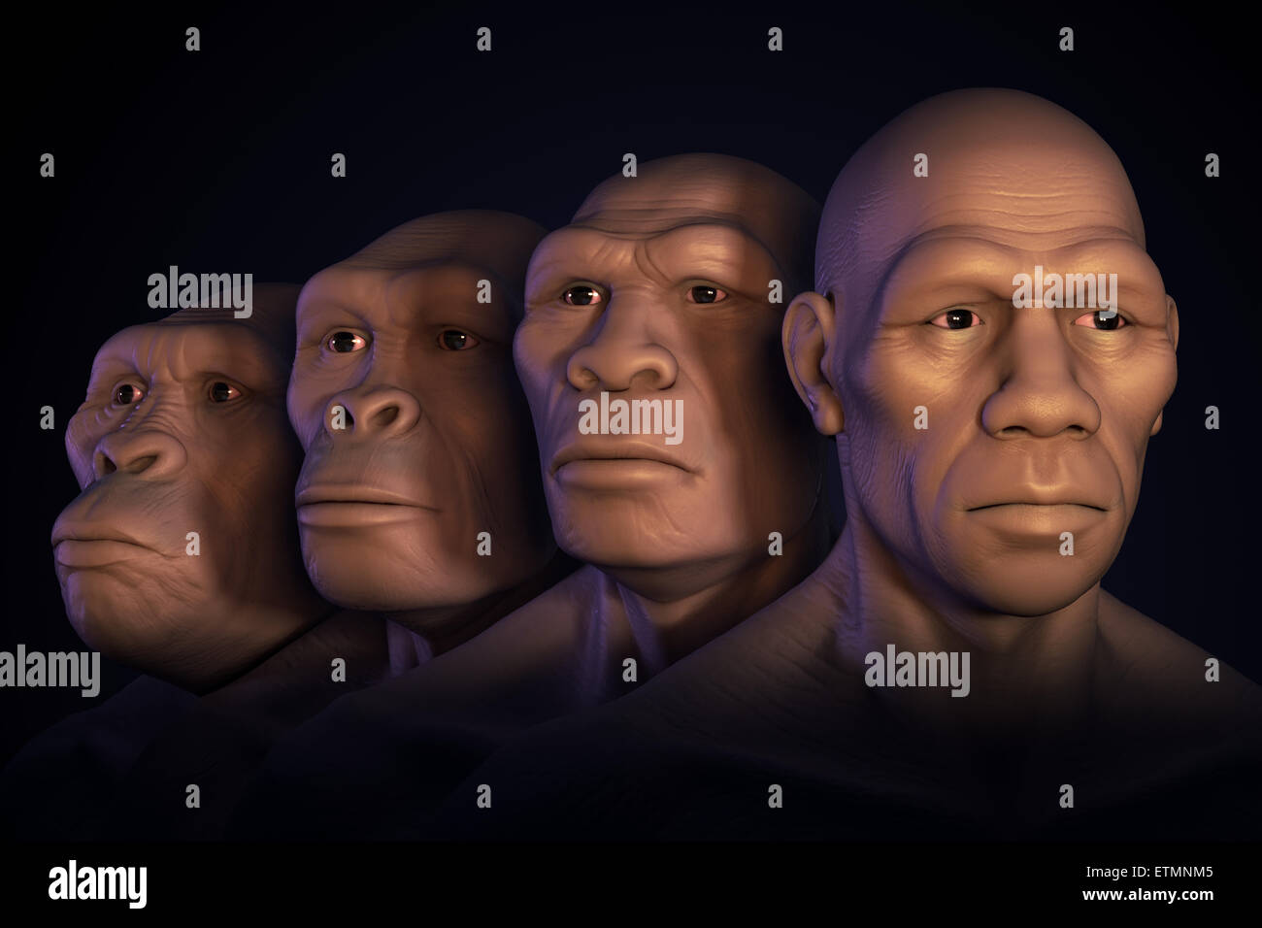
ANTHROPOLOGY
What It Is • Branches • Scope
“Understanding humanity across time, place and culture"
Dr. Neha Singh
Assistant Professor
Dept. of Anthropology

Slide 2
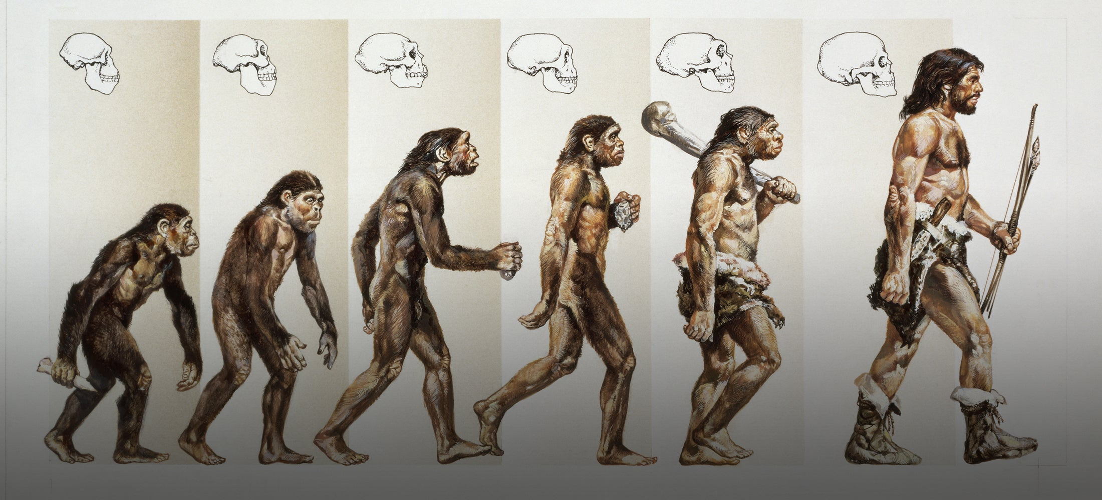
What is Anthropology?
The holistic study of humans and human societies.
• Anthropology is the systematic study of human beings, their cultures, societies, biology and development.
• It asks how humans live, adapt, communicate, organize society and create meaning.
• Anthropologists study both the past and the present—from early humans to contemporary communities.
• A key strength is the holistic perspective: connecting biological, cultural, social, linguistic and archaeological evidence.
2

Slide 3
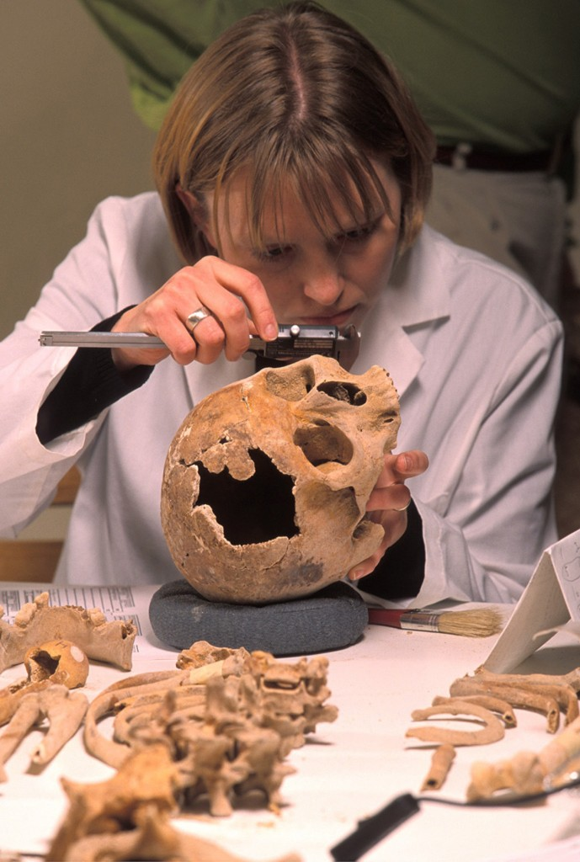
The Meaning of Anthropology
Anthropology
Study and understanding of humanity
Anthropos
Logos
Greek: human / humankind
Greek: study / knowledge
• It combines scientific observation, fieldwork, comparison and interpretation.
• The discipline values cultural context and seeks to understand people from their own perspectives.
3

Slide 4

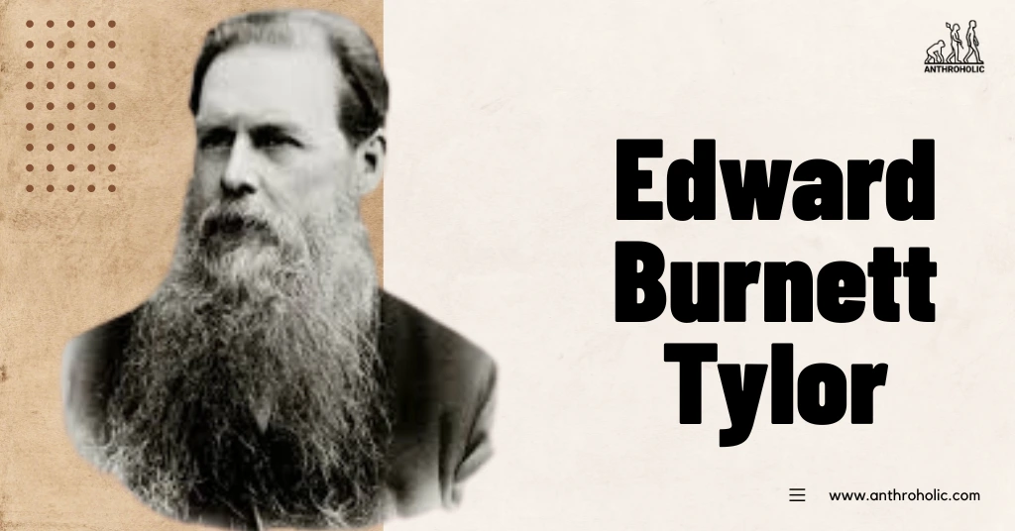
Foundational or philosophical "father of anthropology
Father of cultural anthropology

Slide 5
What Questions Does Anthropology Ask?
Human origins
Culture
Society
Why do people have different beliefs, customs and traditions?
How are families, communities and institutions organized?
Where did humans come from? How did we evolve?
Language
Material past
Change
How does language shape identity, thought and interaction?
What can artifacts and sites tell us about earlier societies?
How do people and cultures adapt to social and environmental change?
4

Slide 6
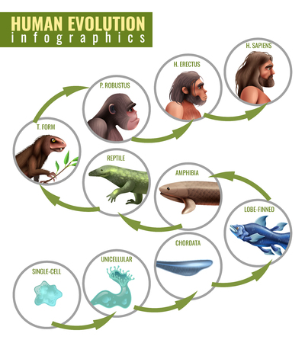

Earth formed about 4.6 billion years ago

Slide 7
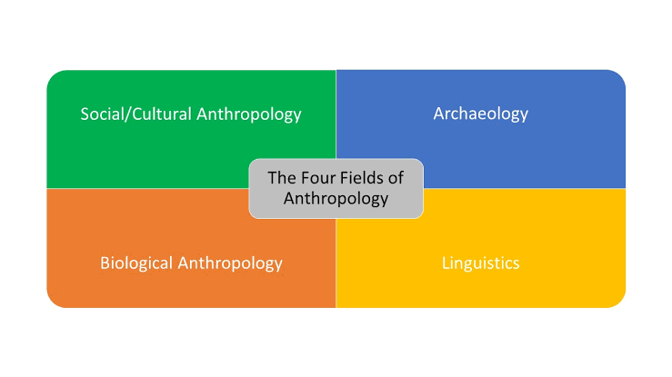

Slide 8
Major Branches of Anthropology
Four interconnected areas form the core of the discipline.
Biological / Physical
Cultural / Social
Human evolution, genetics, variation, adaptation and primates.
Culture, social life, beliefs, institutions, identity and everyday practices.
Archaeological
Linguistic
Past societies through material remains, artifacts, sites and landscapes.
Language, communication, meaning, identity and the relationship between language and culture.
5

Slide 9

"Father of Anthropology

Slide 10
Branch 1 — Social/ Cultural Anthropology
• Explores how people create, learn and share culture.
• Topics include family and kinship, religion, economy, politics, gender, education, migration and globalization.
• A central method is ethnography: learning about everyday life through sustained fieldwork and observation.
• Applications include community development, policy, education, organizational research and cross-cultural communication.
7

Slide 11
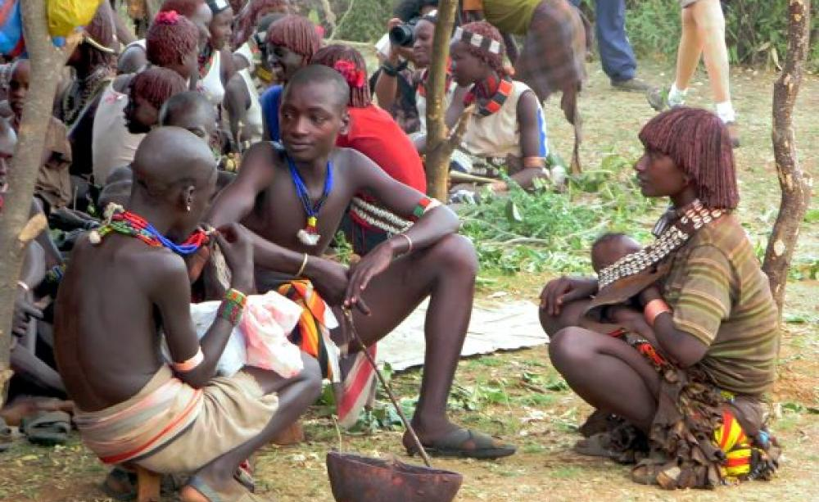
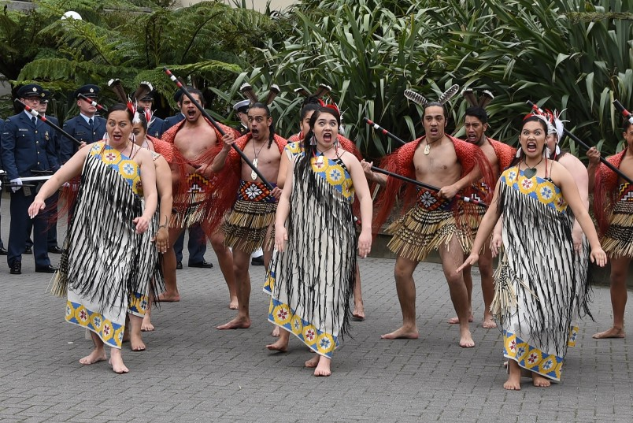

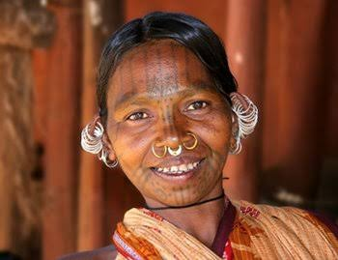
Image credit: Google Pictures

Slide 12
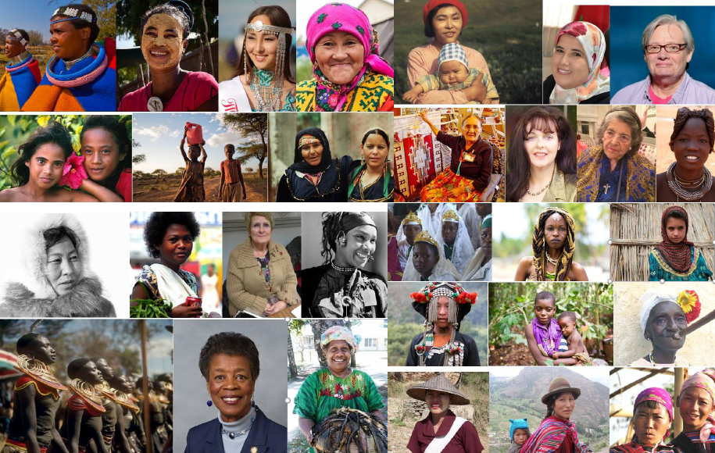
Image credit: Google Pictures

Slide 13
MALE
FEMALE

Slide 14
MARRIED
DIVORCED

Slide 15
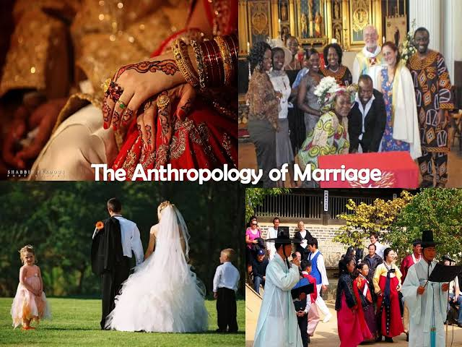
Image credit: Google Pictures

Slide 16
Scope:
Study of human society and culture.
It concerns the study of social institutions such as family, marriage, kinship, religion, economic organization, political organization, law and the relations between such institutions.
It is based on the facts, collected through direct investigation from the field using anthropological techniques.
It attempts to understand culture as a major mechanism by which human beings adapt to their environment
It is a study of relations and patterns of life among different types of people
Examines the social and cultural peculiarities of human life.

Slide 17
Branch 2— Biological Anthropology
• Studies humans as biological organisms and examines human evolution and biological variation.
• Major areas include paleoanthropology, human genetics, primatology and human adaptation.
• Applications include forensic identification, evolutionary research, biological diversity and public-health research.
• Example: studying skeletal remains to understand age, biological variation and past living conditions.
6

Slide 18
Definition:
Paul Broca defines Biological Anthropology as “the science whose objective is the study of humanity considered as a whole in its parts and in relationship to the rest of nature”.
Sub-branches: There are many sub-branches/fields in biological anthropology. They are Primatology, Paleoanthropology, Human Genetics, Forensic Anthropology, Serology (ABO Blood Group), Dermatoglyphics, etc.
Human Genetics:
  It deals with inheritance and variation thereby help in understanding how evolution works.
Forensic Anthropology:
  It is a branch of biological anthropology that helps to identify individuals, criminals, victims of misshapes and natural calamities, etc.
  From the analysis of DNA, hair with root, bloodstains, drops of semen, body fluids, skin cells, cells of bone- marrow, fingerprints, skeletal remains, etc., forensic anthropologists are able to identify such persons.
Serology:
  It is a scientific study of blood groups. It studies plasma serum and other red cell enzymes.
  Diagnostic identification of antibodies in the serum
Dermatoglyphics is the study of skin ridges on finger palms, toes, and soles.

Slide 19

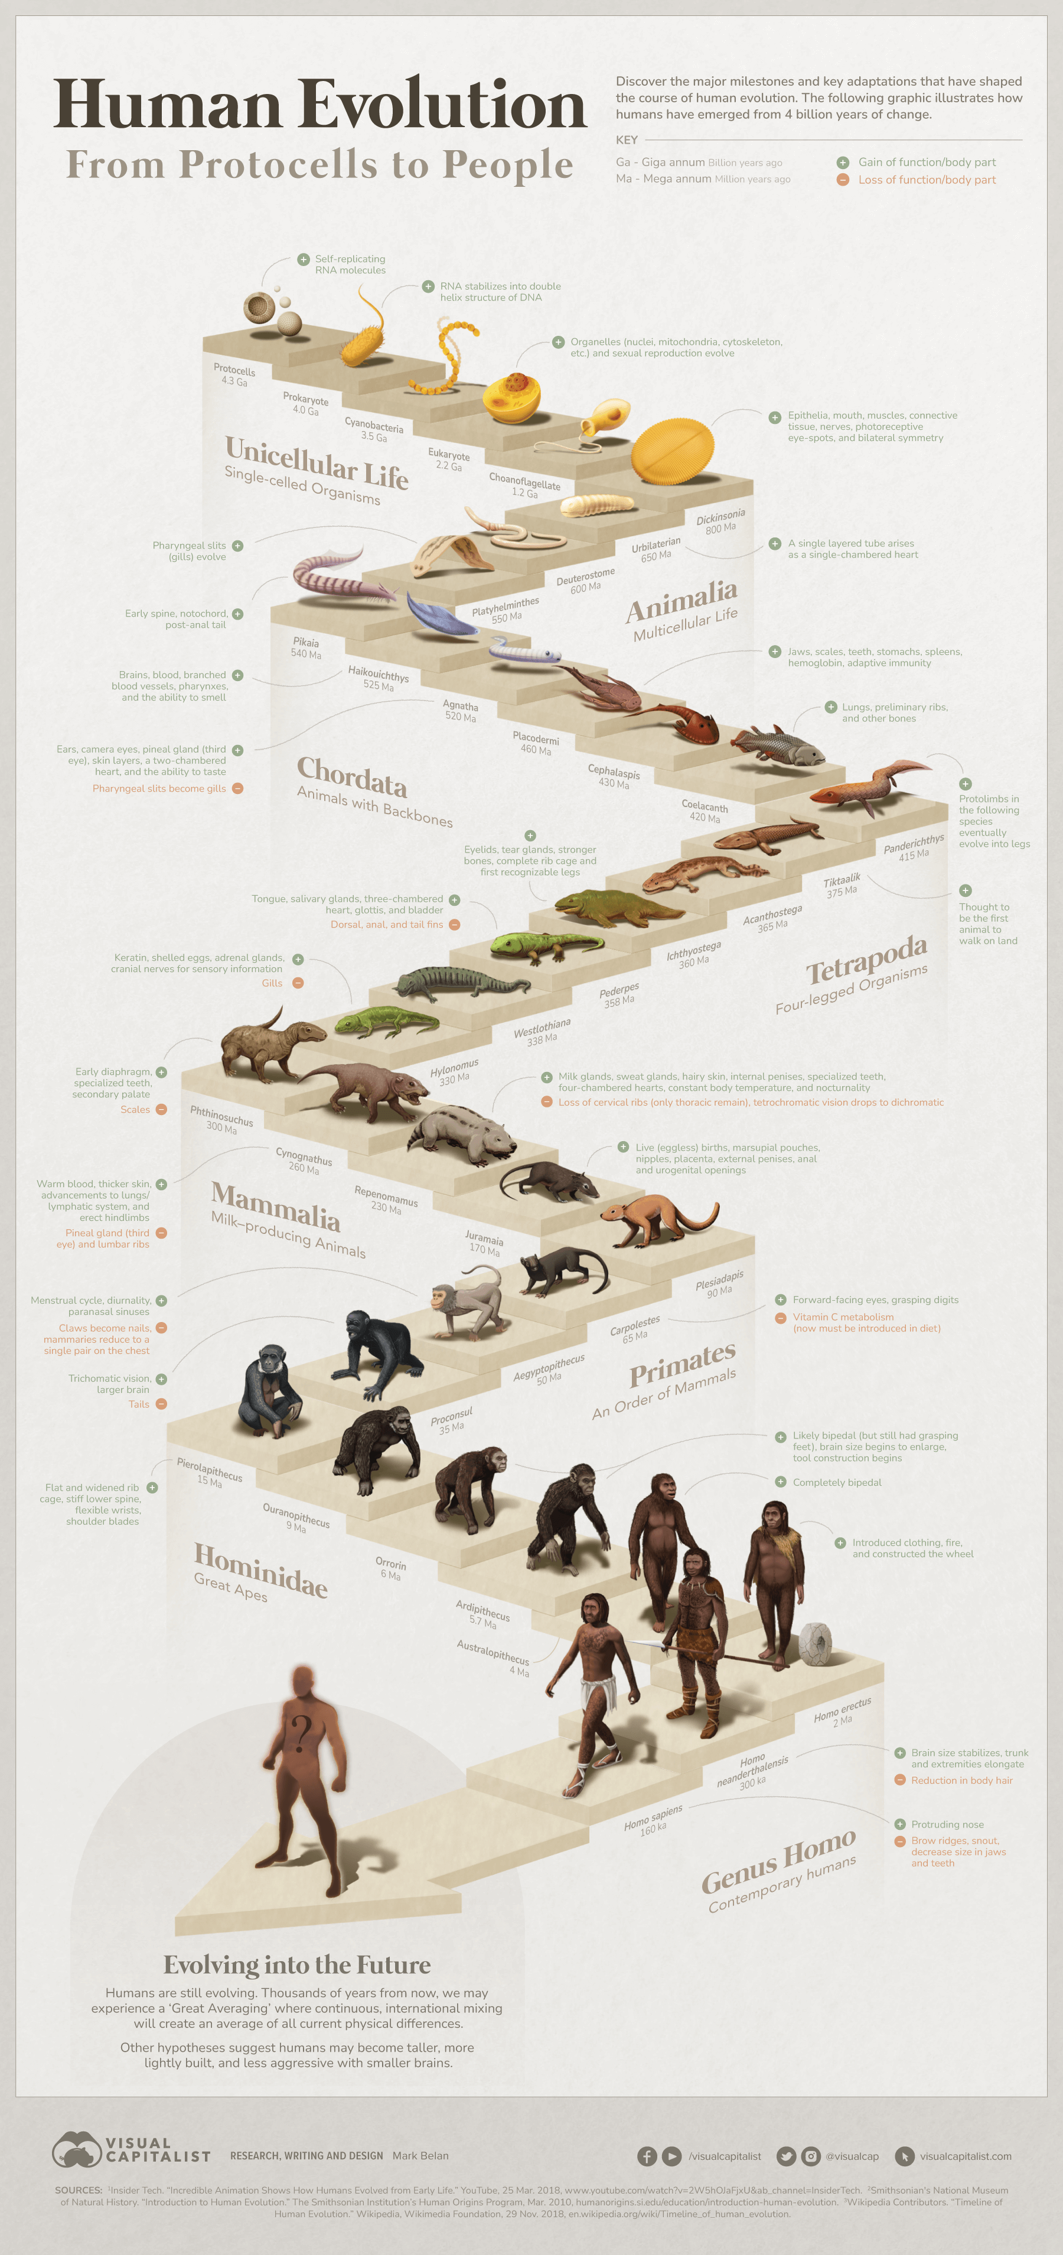
CHARLES DARWIN
Image credit: Google Pictures

Slide 20
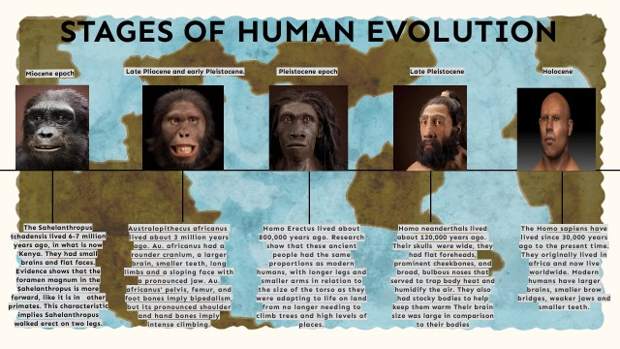
Image credit: Google Pictures

Slide 21
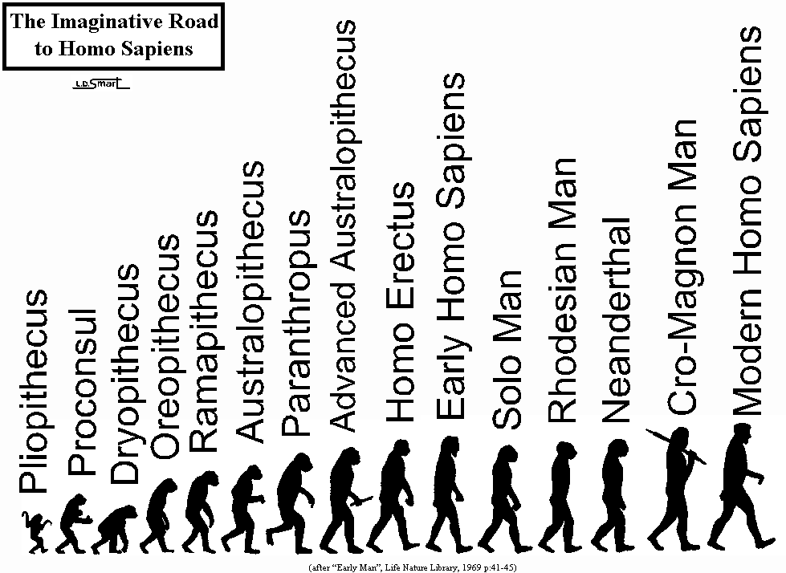

Slide 22
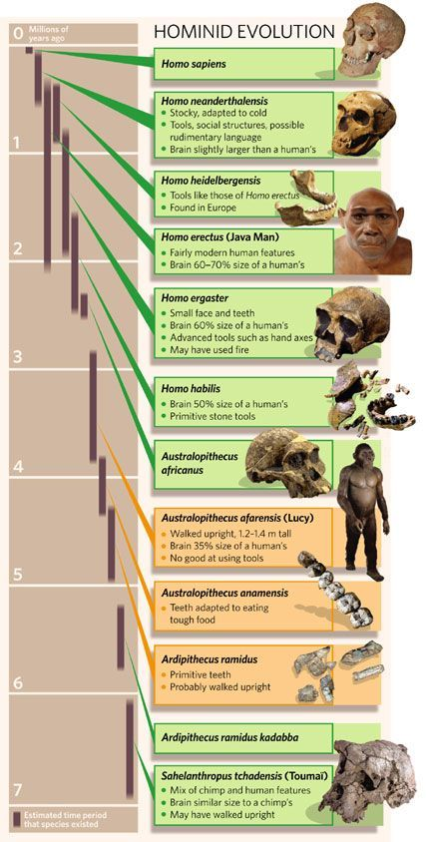

Slide 23
Scope:
It studies human evolution and human variation.
It is the branch of Anthropology that considers humans as biological organisms.
It helps to understand the physical differences and changes among humans.
Study of origin and evolution of humans and analyses their diversity.
It examines the bio-social adaptation of different human populations living in different geographical and ecological settings.

Slide 24
Branch 3 — Archaeological Anthropology
• Reconstructs past human life from material evidence such as tools, pottery, architecture, burials and landscapes.
• Combines excavation, dating, laboratory analysis, mapping and interpretation.
• Helps explain changes in technology, settlement, trade, food systems and social organization.
• Applications include heritage conservation, museums, cultural resource management and research.
8

Slide 25
Archaeological Anthropology:
Archaeological anthropology is one of the sub-branches of anthropology deals with the origin and development of human species and its material manifestations in the form of material culture.
  It is a branch of anthropology that deals with the study of past cultures through remains left by ancient humans in relation to the environment.
  It has been derived from the broad field of archaeology.
  It deals with the prehistoric period which constitutes over 99% of human history.
  It combines archaeology and anthropology.
  A person interested in archeological aspects with an anthropological perspective becomes an archaeological anthropologist.
Origin: It started in 1797 when a farmer John Frere sent some Acheulean tools found 12 feet below the earth’s surface to “The Society of Antiquities in London” in London.

Slide 26
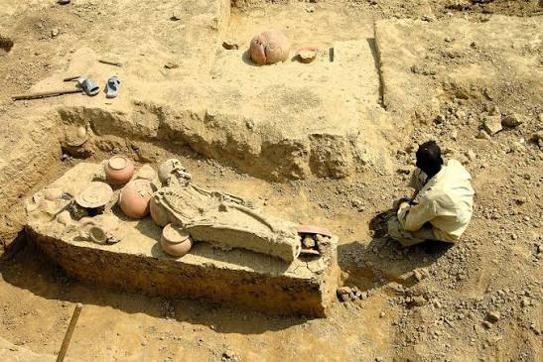
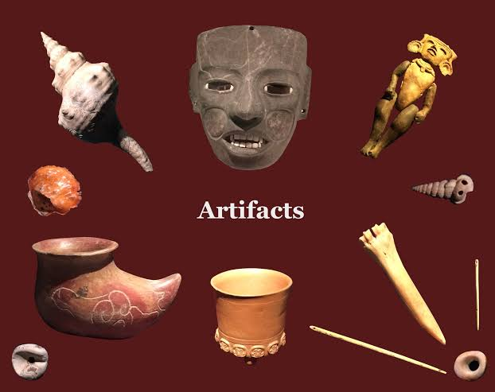
Image credit: Google Pictures

Slide 27
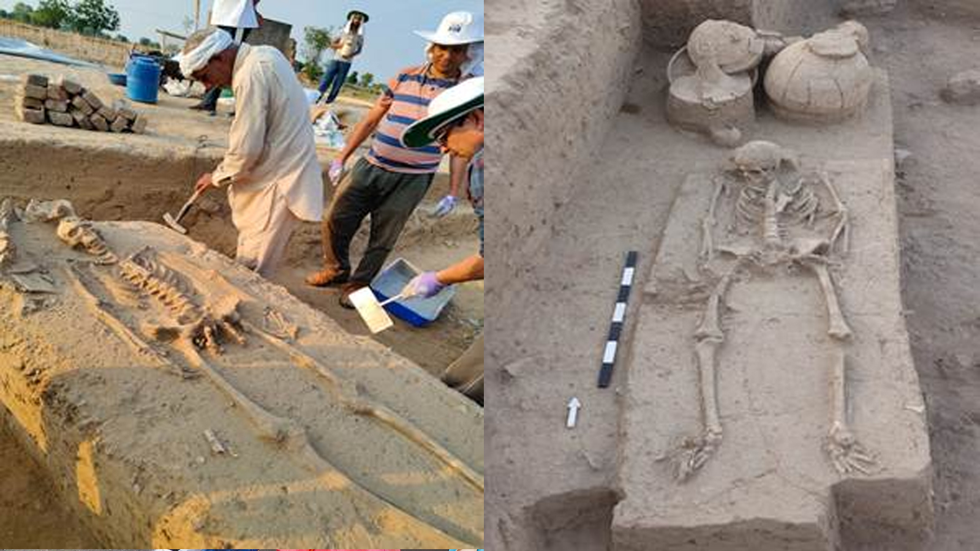
Image credit: Google Pictures

Slide 28
Recent trends:
Aerial Survey (Remote sensing).
Ground Survey.
Computer-Aided Mapping.
Urban Water Archaeology.

Slide 29
Scope:
It focuses on the study of origin and development of a prehistoric culture of human beings.
History is based on written records of past life. The written documents cover only the last five thousand years because the invention of the alphabet took place only around 5000 years BC. Archaeology supplements the rest of the period in the history of humans by reconstructing the ancient past from the material remains.
It tells us about the technology used in the past by the tools people have left behind thereby giving the details about the economic activities of the people.
It helps in understanding the formation of the earth, the emergence and evolution of life through geological age.

Slide 30
Branch 4 — Linguistic Anthropology
• Studies language as a human cultural and social practice.
• Examines communication, multilingualism, language change, identity, power and social relationships.
• Helps us understand how language reflects—and sometimes shapes—culture and social life.
• Applications include language documentation, education, communication research, media and community work.
9

Slide 31

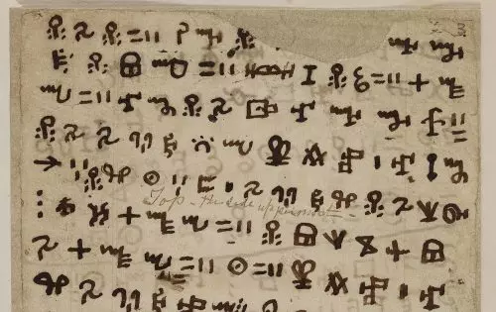
Image credit: Google Pictures

Slide 32
Linguistic Anthropology:
Linguistic Anthropology is a branch of anthropology that deals with the systematic study of language in relation to biological as well as cultural aspects of human beings. It is concerned with the languages of all people, past and present as it is the chief vehicle through which man preserves and transmits his culture from generation to generation.
Origin: In the 17th and 18th century metaphysical writings of philosophers. It is the branch that originated from endeavor to document endangered languages and has grown over the past to encompass most aspects of language structure and use.
Development: E. B. Taylor in his “Research into the early history of mankind” was the first anthropologist to evoke some interest in studying the problem of the origin of language.

Slide 33
Scope:
  It mainly belongs to socio-cultural anthropology and deals with how language is related to various aspects of sociocultural anthropology.
  It examines the origin of evolution and variation of languages as part of human culture.
  It examines the structure of language, its use, origin, development, and classification in relation to specific cultures.
  It studies language as an integral aspect of social life as it is the primary medium of communication and social interaction without which the major social institutions (the family, the law, the polity, and the economy) cannot function in any society.
  It helps to document the disappearing languages particularly tribal languages or language spoken by only a few numbers of people.

Slide 34
How Do Anthropologists Work?
Fieldwork
Participant Observation
Interviews
Close engagement with communities to understand everyday life.
Observing activities while participating appropriately in social settings.
Collecting detailed perspectives, stories and experiences.
Surveys & Data
Archaeological Methods
Laboratory Methods
Excavation, artifact analysis, dating, GIS and documentation.
Studying bones, DNA, biological materials and physical evidence.
Using quantitative methods alongside qualitative evidence.
10

Slide 35
Scope of Anthropology
Academic, public, applied and professional opportunities.
Education & Research
Government & Civil Services
NGOs & Development
Healthcare & Public Health
Community development, livelihoods, education, gender and social-impact programs.
Medical anthropology, health behavior, patient experience and community health research.
Universities, colleges, research institutes and think tanks.
Policy research, tribal affairs, rural development, social welfare and administration.
Corporate & UX Research
Heritage & Museums
Forensics
Media & Communication
Consumer insights, user research, design research and organizational culture.
Archaeology, museums, cultural heritage, conservation and interpretation.
Forensic anthropology, human identification and skeletal analysis.
Cultural research, documentary work and intercultural communication.
11

Slide 36
Career Skills Developed Through Anthropology
Research & fieldwork
Critical thinking
Qualitative analysis
Data interpretation
Cross-cultural communication
Interviewing & observation
Report writing
Ethical practice
Problem solving
Teamwork & collaboration
These skills are transferable across academic, government, development, research and private-sector careers.
12

Slide 37
Anthropology in India
• Indian anthropology has a strong tradition of studying tribal, rural and urban communities, social institutions and cultural change.
• It contributes to research on tribal development, social policy, health, migration, identity, heritage and human diversity.
• Anthropological knowledge can support culturally sensitive public programs and community-based development.
• For students, the subject can connect academic study with research, teaching, public service, development work and applied careers.
13

Slide 38
Why Study Anthropology?
• It provides a holistic understanding of human beings.
• It connects biology, culture, language, society and the past.
• It develops strong research and communication skills.
• Its scope extends from universities and museums to government, NGOs, healthcare and industry.
• Anthropology teaches us to understand human diversity with evidence, context and empathy.

Slide 39
Environmental Anthropology: With increasing awareness of environmental challenges, Anthropologists are exploring the interactions between human societies and their environments. This includes studying issues such as climate change, sustainable practices, and the impact of human activities on ecosystems.
Digital Anthropology: The growing influence of digital technologies on society has led to the emergence of digital anthropology. This field examines how digital platforms, virtual communities, and online interactions shape social relationships, identities, and cultural practices.
Medical Anthropology: Medical Anthropology explores the social, Cultural, and political dimensions of health and illness. This field examines topics such as healthcare systems, healing practices, and the social determinants of health.
Applied Anthropology: Applied anthropology involves using anthropological insights and methods to address practical problems and contribute to real-world issues. This includes working in areas such as public policy, Social justice, community development, and organisational consulting.
Visual Anthropology: Uses photography, film, and new media to document, analyze, and communicate cultural behaviors and stories.
Public Anthropology: Translates anthropological research into actionable solutions for public policy, social justice, and community advocacy.

Slide 40
References-
Ember, C. R., Ember, M., & Peregrine, P. N. — Anthropology
A comprehensive introduction covering biological, cultural, archaeological, and linguistic anthropology.
Kottak, C. P. — Anthropology: The Exploration of Human Diversity
Very useful for understanding the scope, branches, and basic concepts of anthropology.
Haviland, W. A., Prins, H. E. L., Walrath, D., & McBride, B. — Cultural Anthropology: The Human Challenge
Particularly useful for cultural/social anthropology.
Jurmain, R., Kilgore, L., Trevathan, W., & Ciochon, R. L. — Introduction to Physical Anthropology
Useful for biological/physical anthropology and human evolution.
Piddington, R. — An Introduction to Social Anthropology
Helpful for the study of social anthropology.
Google Images
https://praveenkalikeri.wordpress.co
Encyclopaedia Britannica

Slide 41
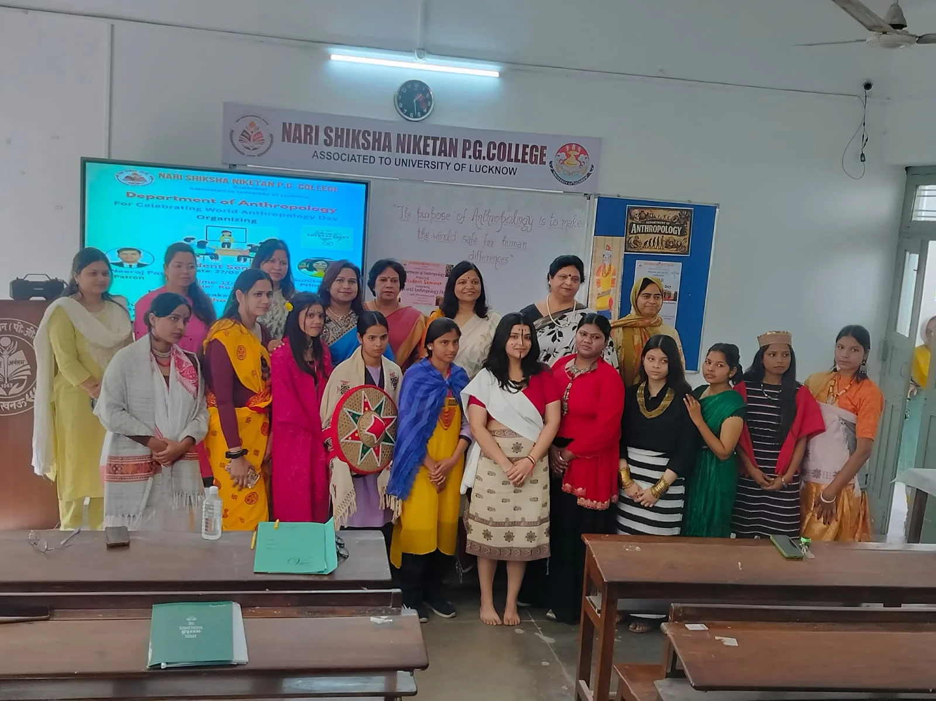
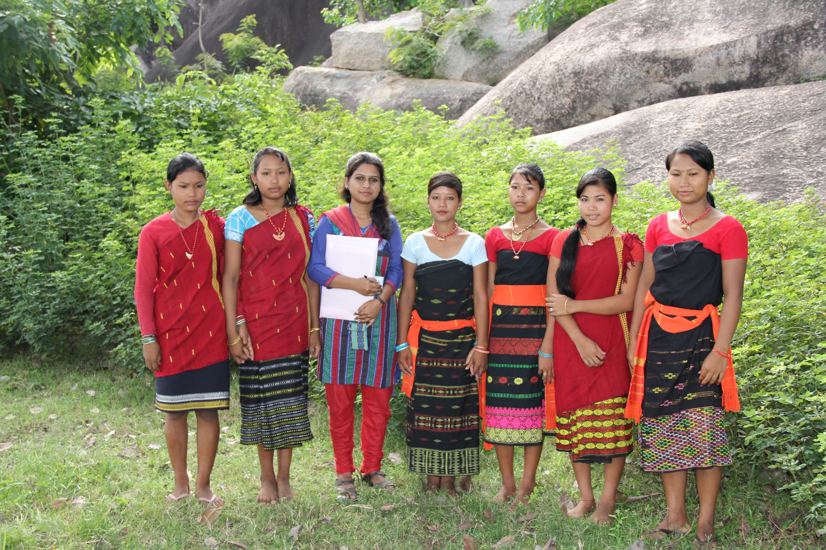
THANK YOU

